Slide 1

PRISM Duplex
Samsung PRISM, Theme 05: Interruptible Real-Time Agents
A local voice agent that holds its plan until you finish, drops stale work when you change your mind, and blocks duplicate actions.
You
Agent
[Team name], [member names], October 2026
Notes:
PRISM Duplex is our Theme 05 submission: a full-duplex voice agent built as a custom LiveKit agent, with every model running locally. The line along the bottom is the idea in one picture: the user's voice above the line, the agent's below, on one clock. Where they overlap, the user is talking over the agent, and the agent has to cope with that rather than wait for its turn.

Slide 2
Assistants take turns. People don’t.
“Take me to the airport… actually, the office first.”
Theme 05 asks for all three at once:
Stay responsive
Speak within a few hundred milliseconds. No dead air, no false “done”.
A turn-taking agent
route: airport
route: office
Both calls are logged, so the benchmark fails the scenario.
Work asynchronously
PRISM Duplex
Tools and reasoning run in the background without blocking the conversation.
route: office
One call, sent after you finish speaking.
Recover cleanly
Drop stale intent, update arguments, and never repeat a state-changing action.
2 / 8
Notes:
Real people pause, hesitate and correct themselves mid-sentence. A turn-taking assistant acts on the first half of the sentence, so a stale route to the airport gets computed before the correction arrives. On Full-Duplex-Bench v3 a scenario passes only if exactly the expected tools are called with the right arguments, so one stale call fails the whole scenario. The brief asks for three things at once: respond fast, never block on tools, and recover cleanly from corrections without repeating actions.

Slide 3
Three layers on one clock
Fast path
keeps the floor
Room audio
Speech to text
Acknowledge
mic or benchmark WAV via LiveKit
Silero VAD, then Parakeet-TDT
“One moment.” if planning is slow
Coordinator
decides when to act
Intent resolver
Commit gate
Ledger
Qwen3 plan; the last value wins
waits 350–700 ms for more words
blocks an identical write
Slow path
does the work
Spoken reply
Responder
Tools
Executor
Kokoro-82M voice into the room
a reply grounded in results
FDB-v3 mocks or the car backend
async calls; stale reads cancelled
Runs locally: Qwen3 on MLX or vLLM, Parakeet-TDT 0.6B, Kokoro-82M and Silero VAD, carried over LiveKit.
3 / 8
Notes:
The fast path keeps the floor: voice activity detection and Parakeet transcribe each finished segment locally, and if planning takes longer than 700 milliseconds the agent says a generic "One moment." It never claims completion. The coordinator decides when to act: Qwen3 turns the possibly disfluent request into a plan of tool calls, the commit gate holds that plan briefly in case the user keeps talking, and the ledger keys every state-changing call by tool and arguments so an identical one is blocked. The slow path executes the plan as an async call graph, then the responder grounds a reply in the actual results and Kokoro speaks it back into the room. Every LiveKit room gets its own coordinator, ledger and tool state; nothing is shared between conversations.

Slide 4
Holding the plan until you finish
You
Take me to the airport…
actually, the office first
Gate
held
dropped
held
commit
Tools
airport: never sent
route: office
Agent
“One moment.”
Schematic of one correction, not to scale. The airport plan is dropped before any call is sent.
Hold before acting
New words replan
Stale reads cancelled
No double actions
Reads wait 350 ms and writes 700 ms after you stop; 1.8 s if you sound unfinished.
Speaking again pauses the gate. The held plan is dropped and the merged request is planned again.
After commit, a correction cancels reads in flight. A write already sent finishes and is not resent.
Each state-changing call is keyed by tool and arguments; an identical one is blocked, not rerun.
4 / 8
Notes:
This is the core design choice. Nothing executes until the utterance is resolved and has passed the commit gate. When the user pauses after "take me to the airport", the plan is held; when they keep talking, the held plan is dropped, the new words are merged, and the whole request is planned again. So the airport route is never sent. If a correction arrives after commit, reads still in flight are cancelled as stale. A write that has already been dispatched is allowed to finish rather than leaving an unknown state, and it is never sent twice. We are honest about the limit: the ledger is in memory, so there is no exactly-once guarantee across crashes or restarts.

Slide 5
Results on Full-Duplex-Bench v3
Strict pass rate on all 100 scenarios
Pass rate by domain
58/100
Finance and billing
84.0%
E-commerce support
72.4%
82.3%
69.9%
Travel and identity
45.0%
right tools chosen, in answered scenarios
right arguments, in answered scenarios
Housing and location
26.9%
87/100
4.94 s
scenarios where the agent took its turn
mean time to respond
Our own run on 25 Sep 2026: Apple Silicon, Qwen3-8B 4-bit, MLX speech recognition in place of NeMo, exact-match scoring with no LLM judge. The current code has not been re-run yet; only the organizers’ re-run is official.
5 / 8
Notes:
Our best full run passes 58 of the 100 FDB-v3 scenarios under strict scoring: every expected tool, correct arguments, nothing extra. When the agent did take its turn, it chose the right tools 82.3% of the time and the right arguments 69.9% of the time. Finance and e-commerce are strong; travel and housing are where we lose most. Please read the caveats: this was scored by exact match rather than the official LLM judge, on a Mac with an MLX port of the same Parakeet checkpoint, and on the revision from 25 September. These are self-reported numbers; only the organizers' re-run with the pinned judge counts.

Slide 6
Failures are missed calls, not stale ones
Why 42 of 100 scenarios failed
Pass rate by chained calls
1 call, 66 scenarios
66.7%
23 made no tool call at all
2 calls, 18 scenarios
50.0%
3 made some expected calls, missed others
3 calls, 16 scenarios
31.2%
15 chose the right tools with wrong arguments
1 made an extra call
Only one failure came from an extra call, the error the commit gate exists to prevent. Self-correction scenarios pass at 58.8%, level with the overall rate.
6 / 8
Notes:
This is the most useful slide for us. Of the 42 failed scenarios, only one failed because of an extra tool call, which is exactly the stale or duplicate call our commit gate is designed to prevent. More than half the failures, 23, are scenarios where the agent made no tool call at all, and 15 picked the right tools with wrong arguments. Longer chains are harder: three-call scenarios pass 5 of 16. Scenarios with self-corrections pass at 58.8 percent, the same as the overall rate, so corrections are not our weak spot; completing multi-step requests is. Same caveat as before: exact-match scoring, our own run.

Slide 7
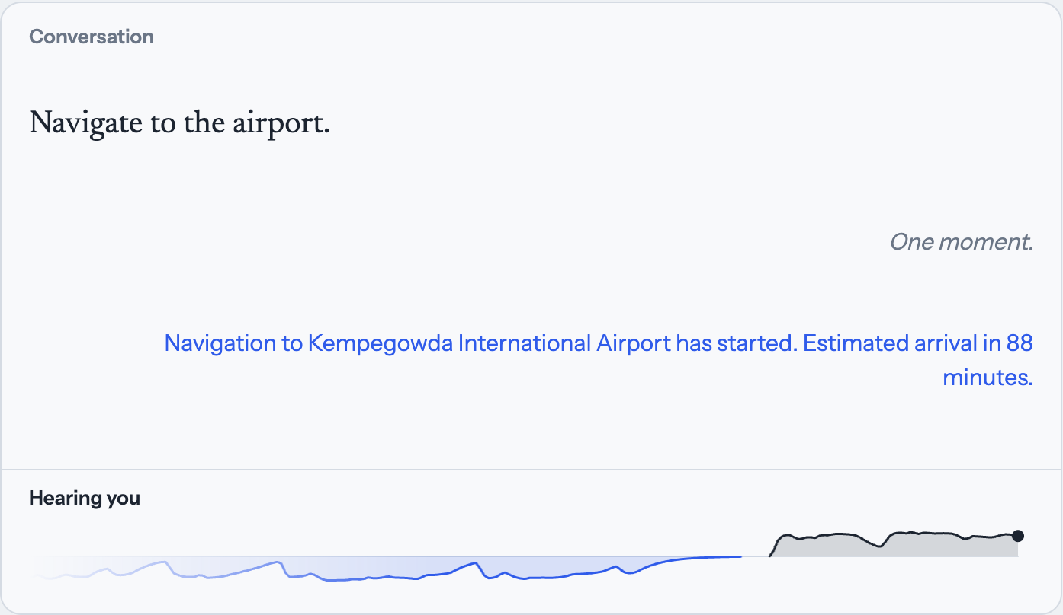
Extension: in-car navigation
Same coordinator, new tool manifest: six tools on a deterministic Bengaluru map.
Mind changed mid-sentence
“Airport… actually, the office first” computes only the office route.
Mind changed after commit
The in-flight airport route is cancelled; navigation starts once.
Talking over the agent
“Add a coffee stop” during the arrival estimate adds one waypoint.
Repeated request
Adding a stop that is already on the route changes nothing.
Live run on 4 Oct 2026. The strip at the bottom shows your voice above the line and the agent’s below, overlapping when you talk over it.
Simulated routes and arrival times: no GPS, traffic or vehicle control.
7 / 8
Notes:
Our extension is a hands-free driving assistant. It reuses the coordinator unchanged; only the tool manifest differs, with six tools: compute route, start navigation, add waypoint, find nearby, cancel navigation and search destination, on a deterministic Bengaluru map. The screenshot is from a live run today: "Navigate to the airport" produced a real route to Kempegowda International Airport with an 88-minute estimate, and the strip shows a follow-up correction heard while the agent was still speaking. The behaviours to demonstrate live are a destination change, a coffee stop added mid-answer, and a repeated stop being ignored. Routing and arrival times are simulated; there is no GPS, traffic or vehicle control.

Slide 8
What we would do next
1
Re-run on the organizers’ setup
Current code on CUDA: Qwen3-14B-AWQ on vLLM, NeMo speech recognition and the official LLM judge, so our number can be compared with theirs.
2
Stop missing calls
23 of 42 failures made no tool call, and three-call chains pass 5 of 16. Study each one and strengthen planning for dependent calls.
3
Cut response time
Stream partial transcripts instead of whole segments. The benchmark mean is 4.94 s, and a cold live reply took about 18 s on a 16 GB Mac.
4
Test with real people
Human microphones, speaker echo and two live rooms at once are still unverified.
8 / 8
Notes:
In priority order. First, re-run the current code the way the organizers will, on CUDA with Qwen3-14B-AWQ, NeMo and the pinned LLM judge, so our self-reported number is comparable. Second, the failure analysis points straight at missed calls and long chains, so that is where the planning work goes. Third, latency: today we transcribe whole segments; streaming partial transcripts would let the planner start earlier. Fourth, everything so far has been tested with recorded and synthetic speech; real people, real speakers and simultaneous rooms still need testing. Thank you.

